Slide 1




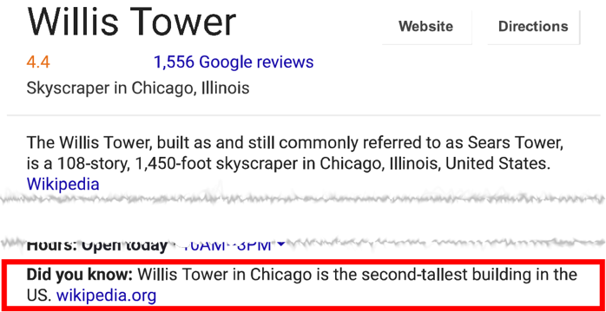
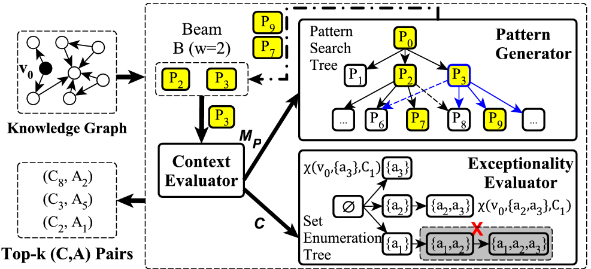
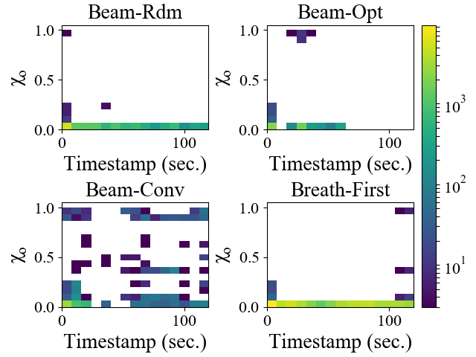

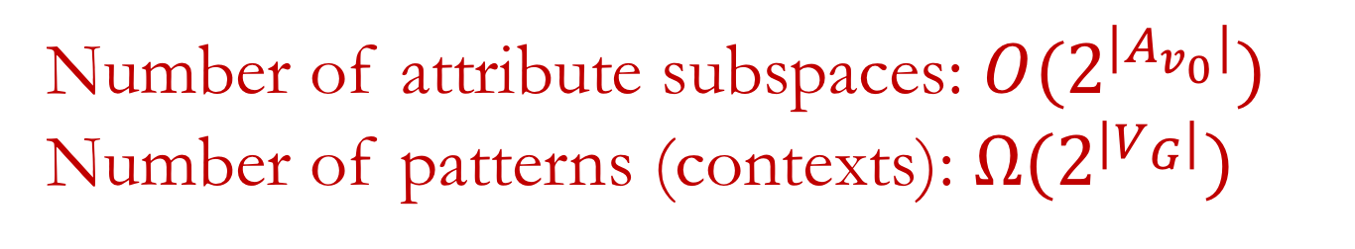
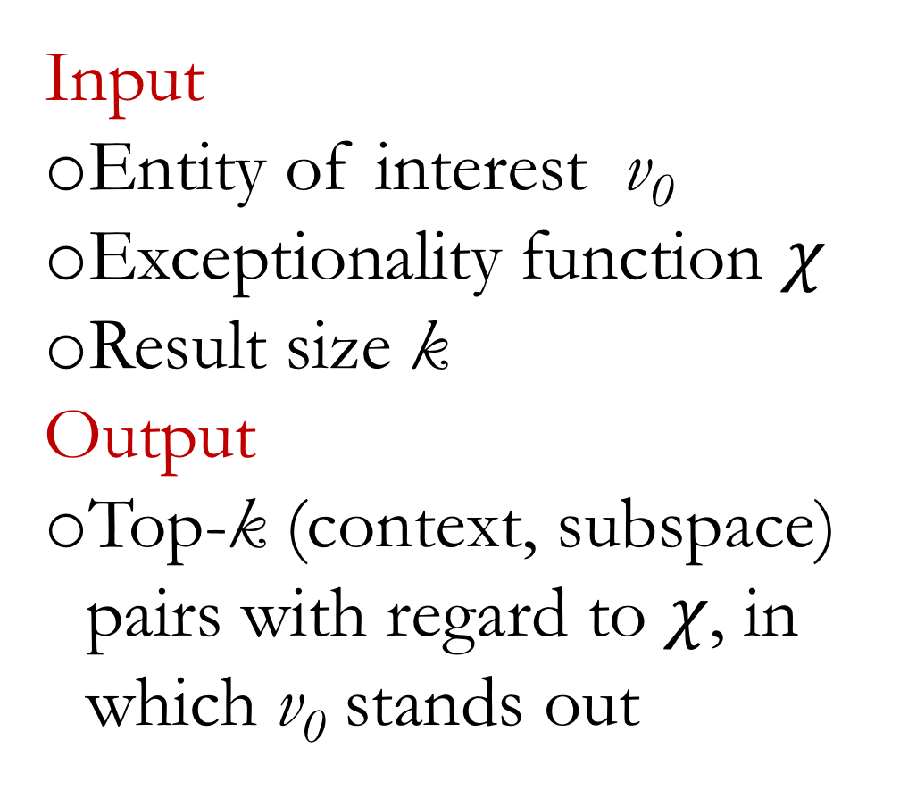
Maverick: Discovering Exceptional Facts from Knowledge Graphs
Gensheng Zhang Damian Jimenez Chengkai Li
Exceptional Facts
Denzel Washington followed Sidney Poitier as only the second black to win the Best Actor award.
Entity of interest
Denzel Washington
Given an entity x
such that
Context
Best Actor award winners
find
This was Brazil's first own goal in World Cup history.
A context
the context has many entities, including x
Attributes
Ethnicity
A set of attributes
(subspace)
Hillary Clinton becomes first female presidential nominee.
Peculiar value
African American
(only two satisfy)
x bears a peculiar value w.r.t. the subspace (few in the context have the value)
Applications
Related Work
Computational Journalism
Fact-finding
Fact-checking
E.g., The first female presidential nominee was Victoria Woodhull, not Hillary Clinton (snopes.com)
Data Cleaning
Recommendation Systems
Friends, news, and product promotion
Outlier detection
Maverick finds conditions that make an object stand out, although the object may not necessarily be an outlier.
Outlying aspect mining
Challenges in adopting existing algorithms:
Many assume a single-table model: a graph can be an extremely large and sparse table
Conjunctive queries on a single table ≠ pattern queries
Multiple tables: unclear how to handle joins
Unclear how to handle set values
Exceptional Facts from Knowledge Graphs
What is exceptional about G1? Among all the goals scored by BRA players, G1 is the only own goal.
G1
S3
scored-by
G3
Attributes: labels of incoming/outgoing edges
Subspace: a subset of attributes
E.g., G1. awarded-to = CRO
Context: entities sharing some common characteristics.
Defined by a pattern-variable pair
awarded-to
scored-by
awarded-to
S1
play-for
G5
play-for
awarded-to
scored-by
play-for
CRO
BRA
S5
S4
awarded-to
G4
play-for
awarded-to
play-for
?g
awarded-to
?s
play-for
BRA
S2
G2
ESP
scored-by
scored-by
E.g., Goals scored by Brazilian players
Problem Formulation
Maverick
Experiments
Input
Entity of interest v₀
Exceptionality function $χ$
Result size k
Output
Top-k (context, subspace) pairs with regard to $χ$, in which v₀ stands out
WCGoals
Created based on FIFA.com
11 node types, 13 edge types
49,078 nodes, 158,114 edges
Film-Award
A subgraph of Freebase
95 node types, 117 edge types
5,437,628 nodes, 10,879,448 edges
Challenges
{}
{scored-by}
{awarded-to}
{match}
Number of attribute subspaces: $O(2^{|A_{v_{0}}|})$
Number of patterns (contexts): $Ω(2^{|V_{G}|})$
See you in Rio!
VLDB2018 demo
{scored-by,
awarded-to}
{scored-by,
match}
{awarded-to,
match}
?g
?g
awarded-to
?t
play-for
?s
?g
awarded-to
?s
play-for
?t
{scored-by, awarded-to, match}
?g
awarded-to
?t
?g
scored-by
?s
?g
awarded-to
?t
play-for
S2
?g
awarded-to
?s
play-for
BRA
?g
awarded-to
CRO
?g
scored-by
S1
?g
awarded-to
CRO
play-for
?s
?g
awarded-to
S1
play-for
?t

